Slide 1



SD33 Indigenizing the Curriculum Project - A Teachers’ Guide:
Phase I
David Schaepe, Ernie Victor,
and Sonny McHalsie
Stó:lō Research & Resource Management Centre / Stó:lō Nation
August 2014

Slide 2
Content
Discussion of ‘Indigenizing’ – What this means regarding curriculum development from a Stó:lō frame of reference
  A concept of ‘Home’/ education process linked to education content = holistic / interconnected / a total system
Indigenizing Framework Diagram / Poster (Dave, Sonny, Ernie)
Salmon and Indigenization (Ernie)
Cultural Viewscape & Watershed GIS Maps – Views from a sample of SD33’s Family of Schools (Dave / Ernie)
Halq'eméylem Place Names and Sxwōxwiyám (Sonny)
Map of Indigenous Curriculum Resource Sites
  A current project: Luckakuck Creek Riparian Restoration Project (Ernie, Robby)

Slide 3
Discussion of ‘Indigenizing’ – What this means regarding curriculum development
Founded in a concept of ‘Home’
Place-based / Landscapes of knowledge
Experiential / Direct & Regular Connection
Seasonal / Non-linear & Cyclical
Storied / Transformative, Collective & Personal
Interconnected / Holistic
  General application, not just an ‘aboriginal’ program
  Meant to connect rather than isolate, separate, categorize peoples
  A total system of educational process and content

Slide 4
WHY Indigenize your Lesson Plan?
  Develops a deeper sense of ‘home’ and meaning to those teaching and learning this form of curriculum
  Enhances relevance of subject matter
  Empowers teachers and students alike
  Works to increase health and well-being within a holistic framework (including individual, family, school, community)
  Establishes a stewardship bond

Slide 5
Explaining elements of the Indigenizing Framework & Details of the ‘How’?
  The ‘Wheel/Whorl’- its center, content (changeable), dynamics and ‘directionality,’ and interconnectedness
  Seasonality / Temporality
  Place / Location / Landscape Profile
  Education / Learning sites and infrastructure
  Curriculum Storyline
    ‘Character’ – salmon
    Materials
    Competencies
    ‘PLOs’
    ‘Mapping out’ and layering content

Slide 6
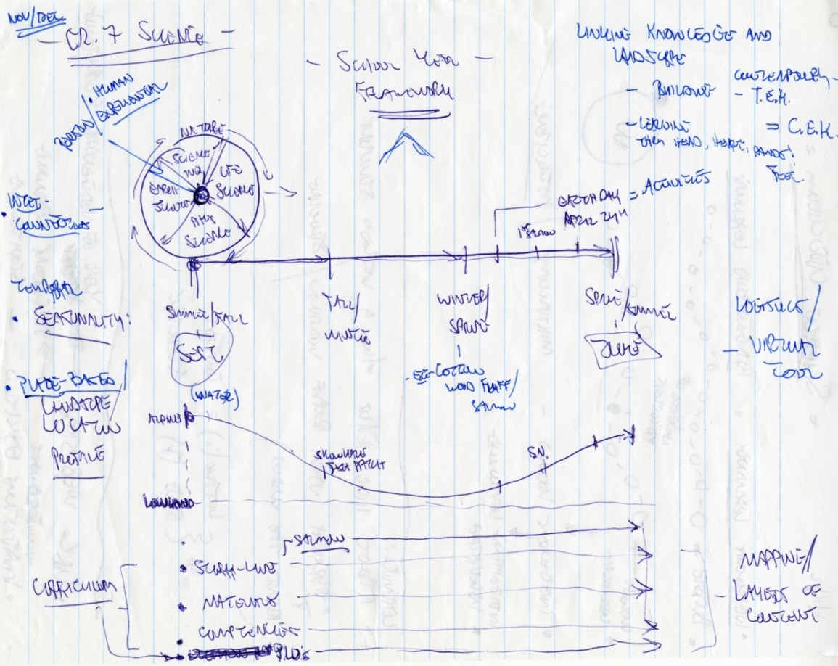
HOW to Indigenize your Lesson Plan:
A Framework for linking up with PLOs
From ‘brainstormed’ to formalized:

Slide 7


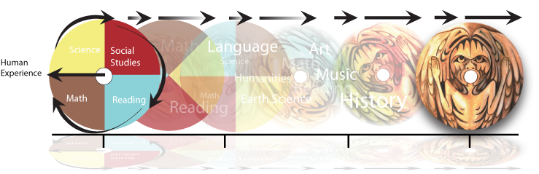
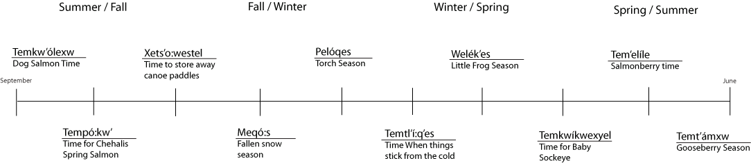
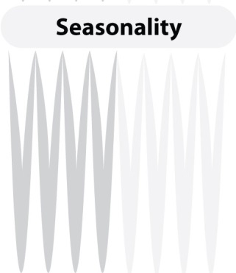
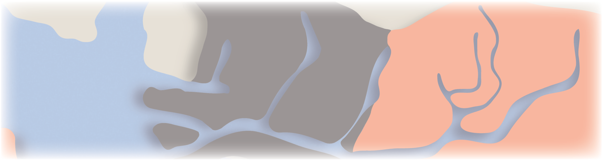


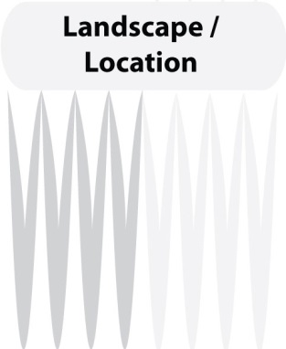
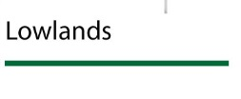

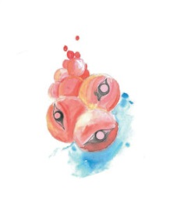
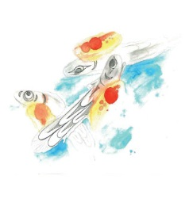
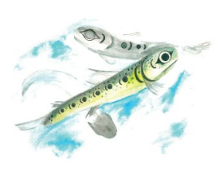
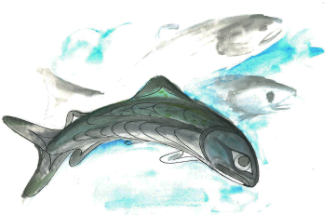
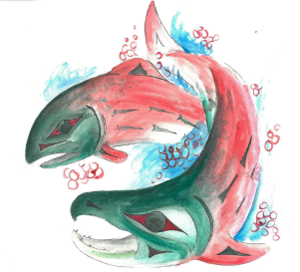
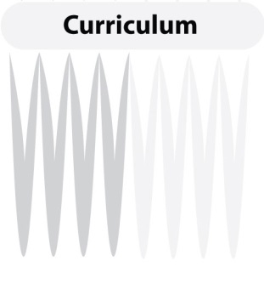

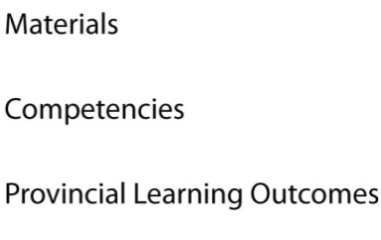

Slide 8
Expanding on Salmon and Indigenous Stó:lō Views
Ernie to speak to:
  Views of salmon from a Stó:lō worldview
  Life cycles within watersheds / creeks / ocean

Slide 9
Salmon and the Ecosystem
The interconnectedness of an ecosystem is dependant upon salmon.
Because the interconnectedness of an ecosystem is highly dependant on salmon, when salmon stocks decline, it affects the ecosystem as a whole.

Slide 10
Sxwōxwiyám as an Indigenous way of Knowing
Story telling as a means of educating
Sonny to speak to:
  the Baby Sockeye story and related sxwōxwiyám
  1. 2. 3.
Ernie to speak to:
  the Mountain Goat Story & Lightning Song

Slide 11
Stó:lō Cultural Viewscapes & Watershed Maps – GIS-based Views from a sample of SD33’s Family of Schools
Add School
photos

Slide 12
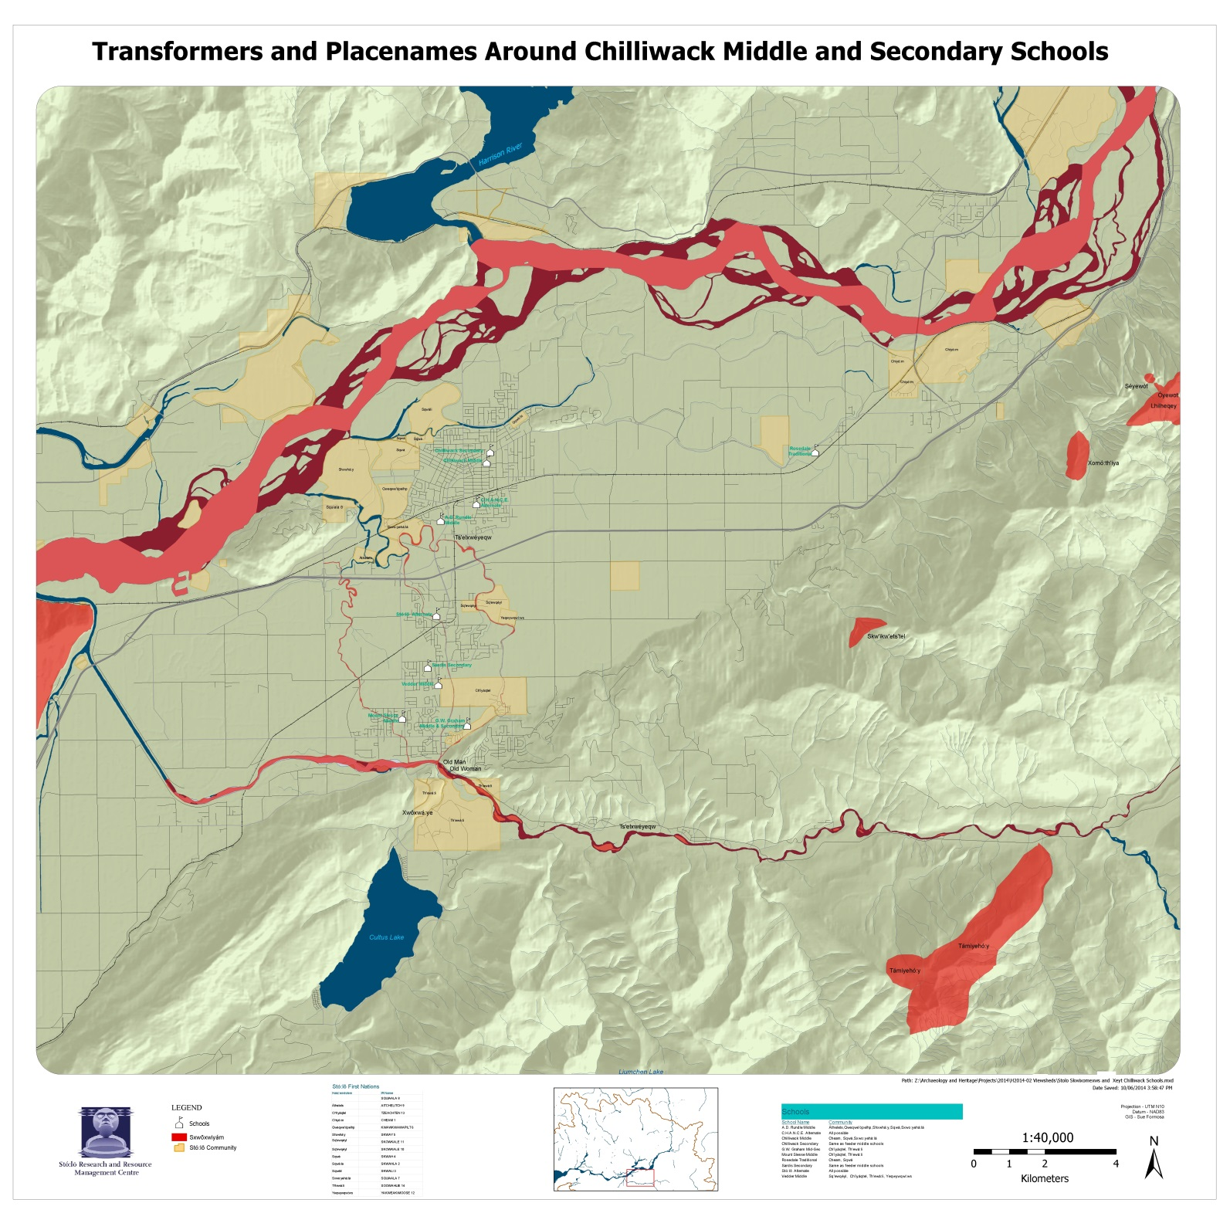

Slide 13
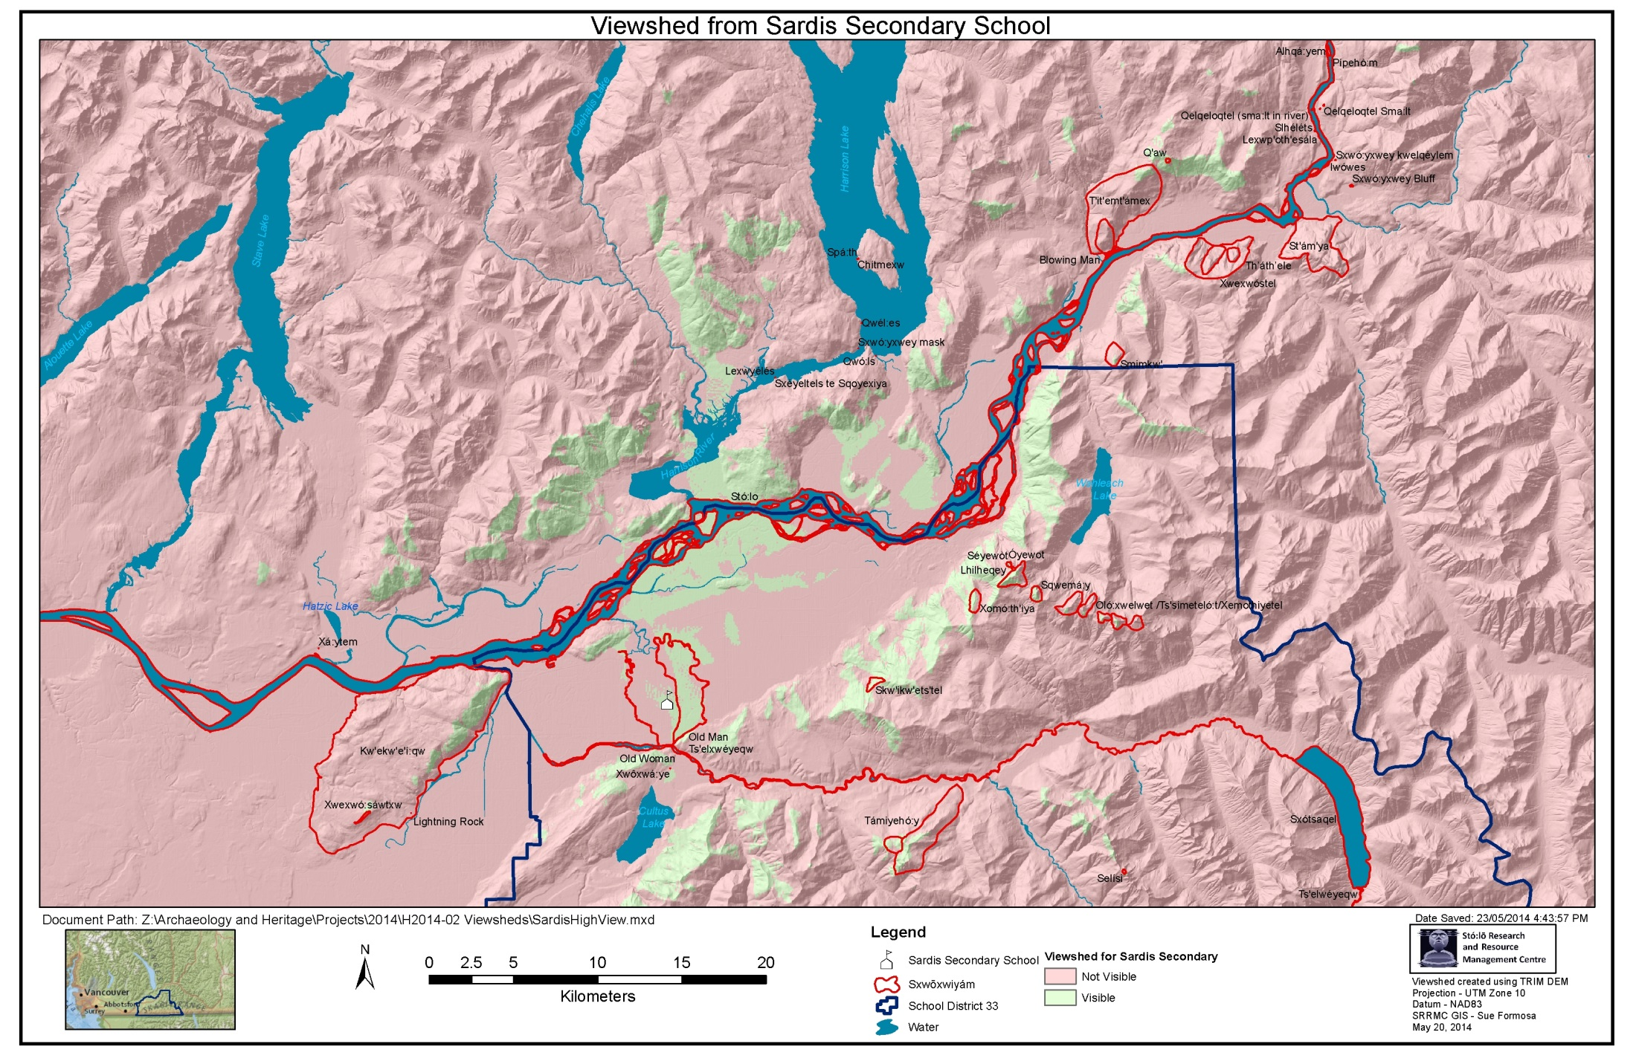

Slide 14
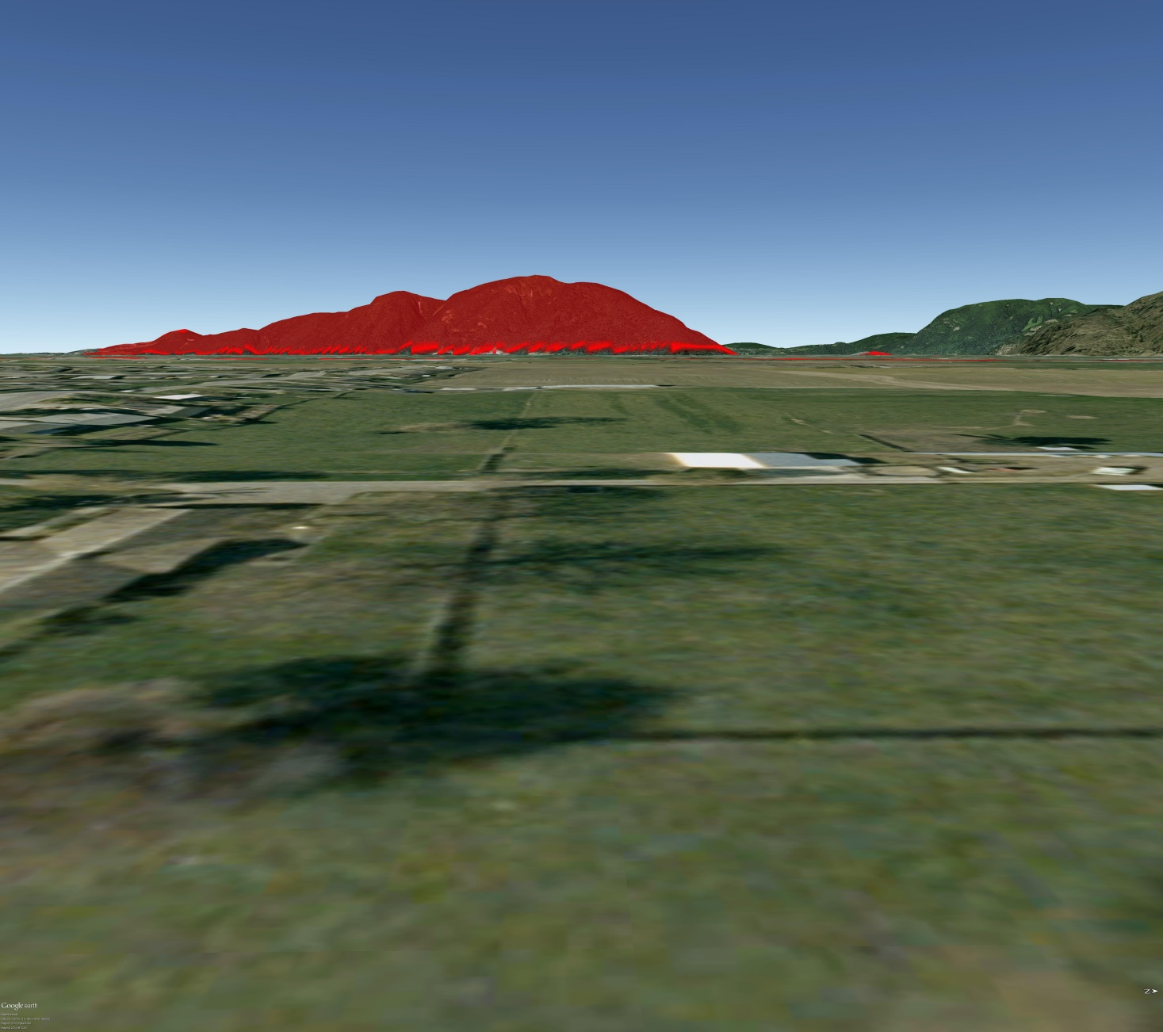
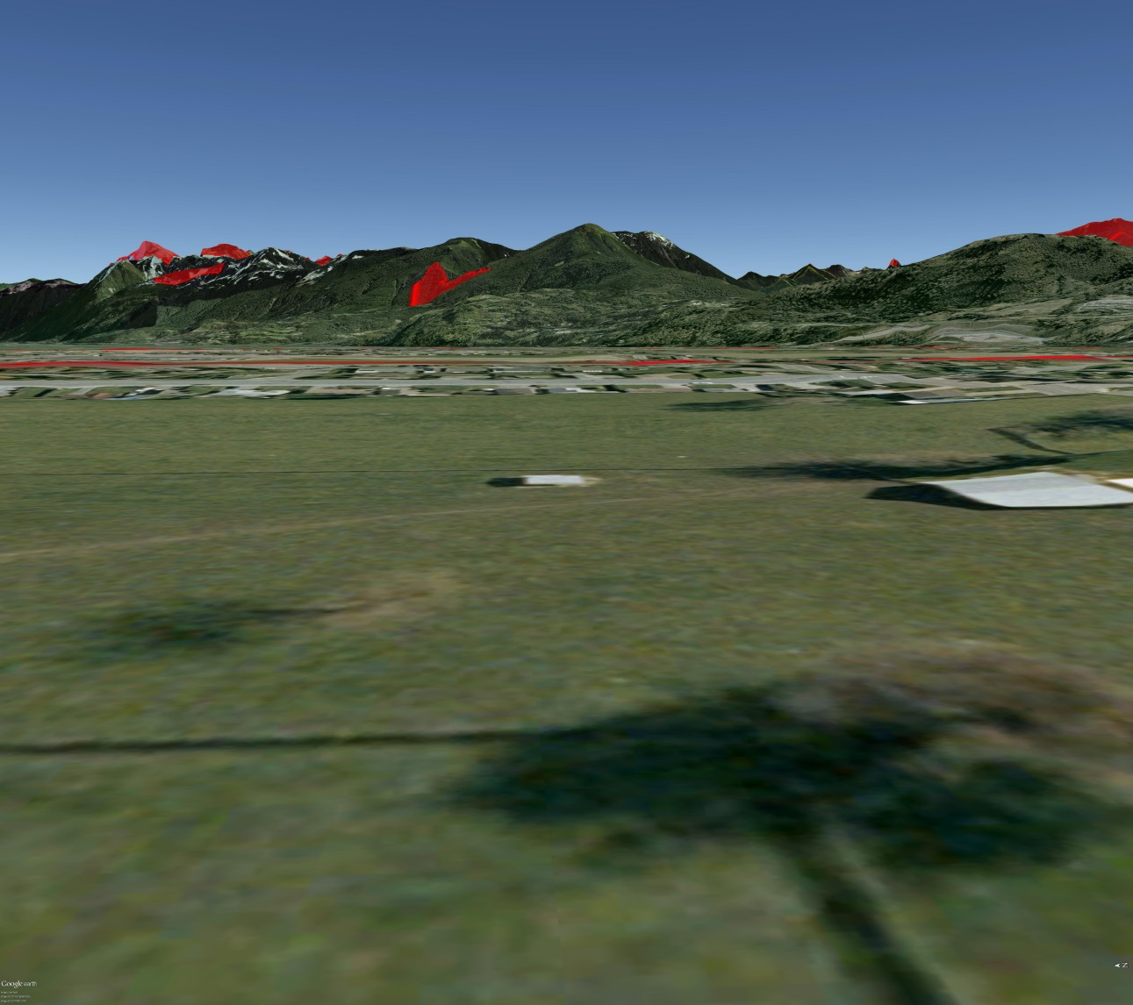

Slide 15
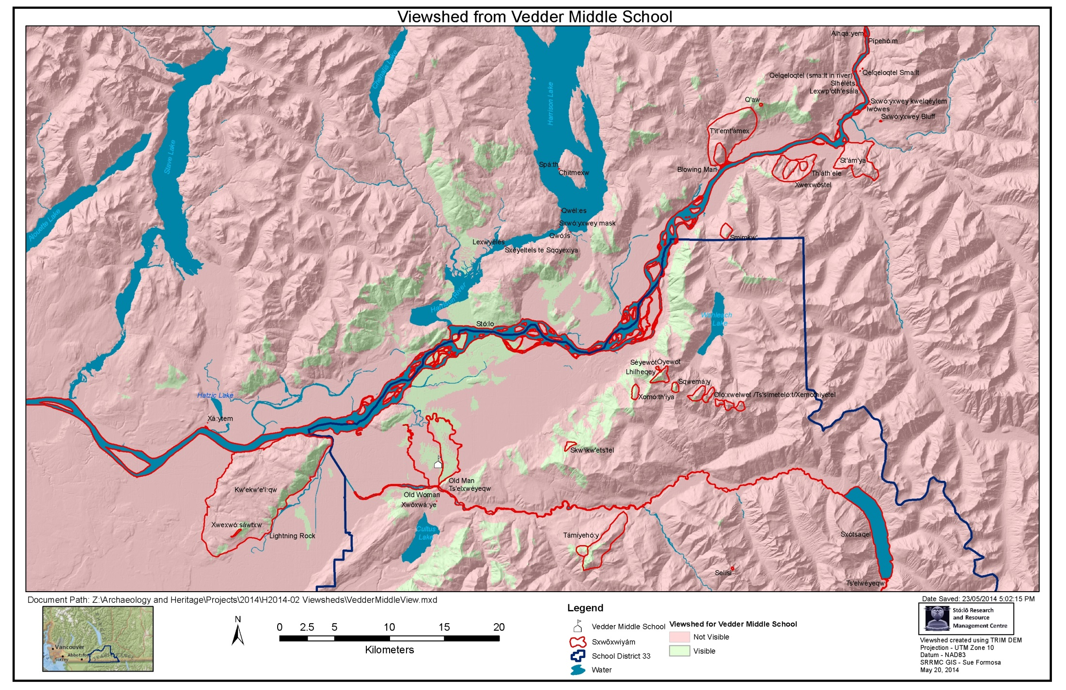

Slide 16
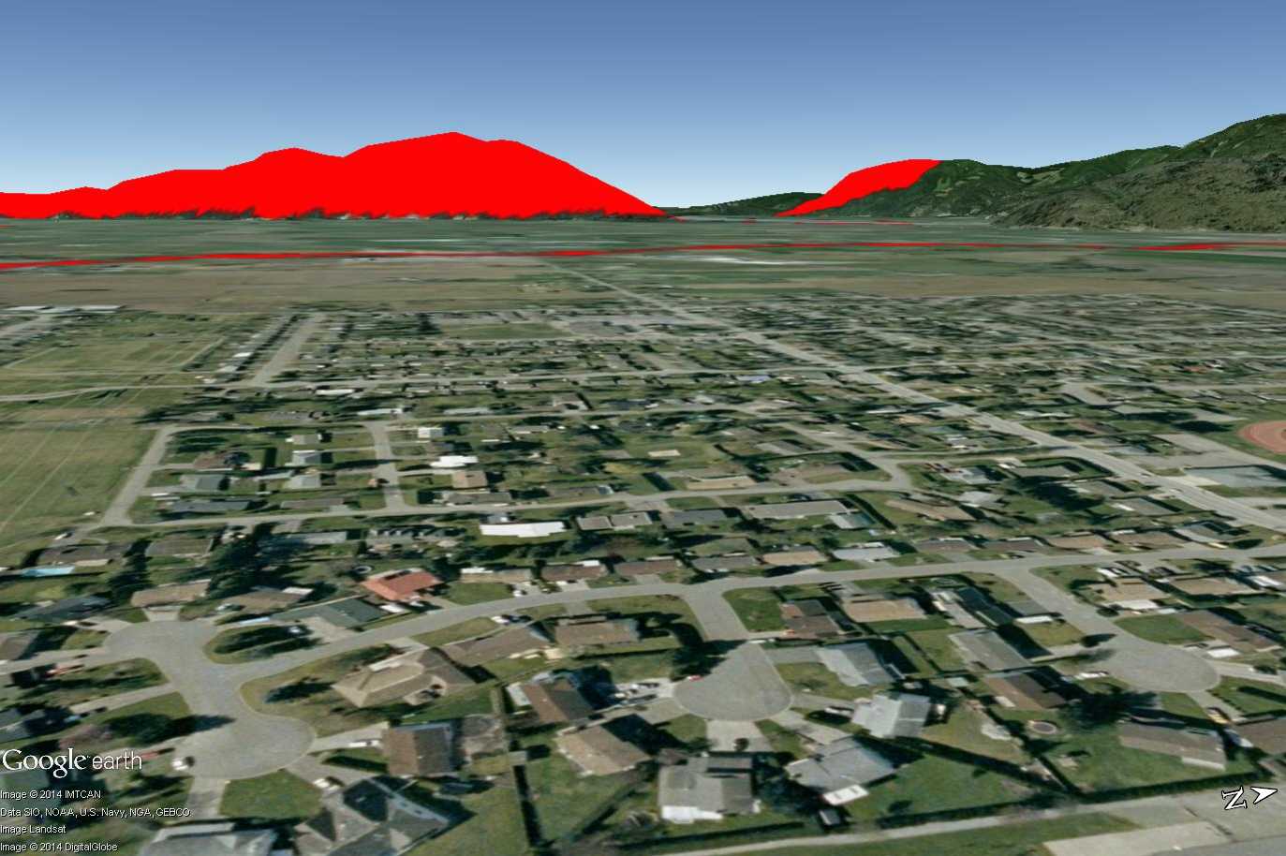
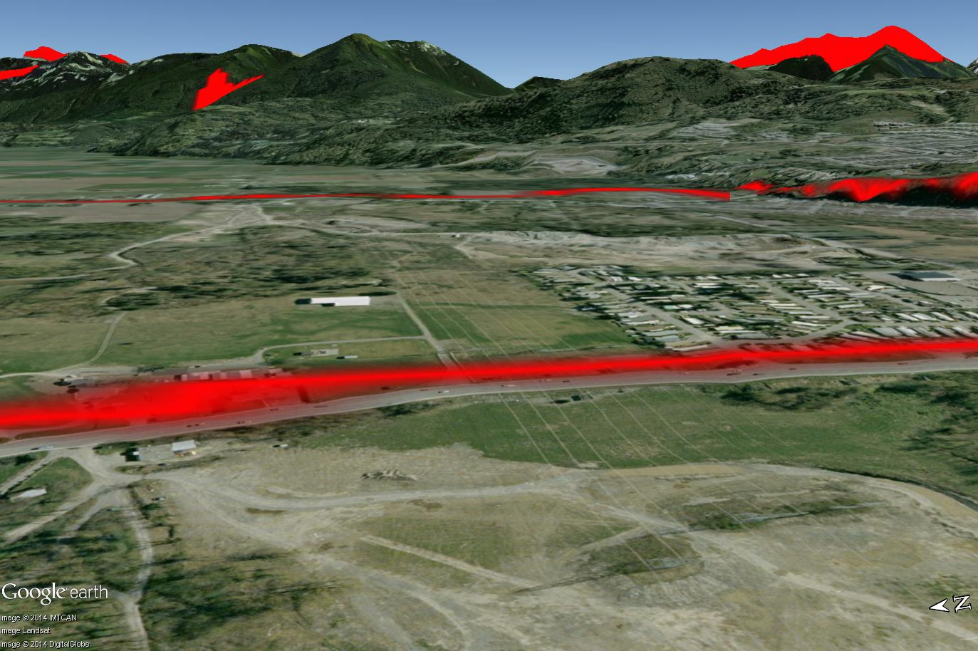

Slide 17
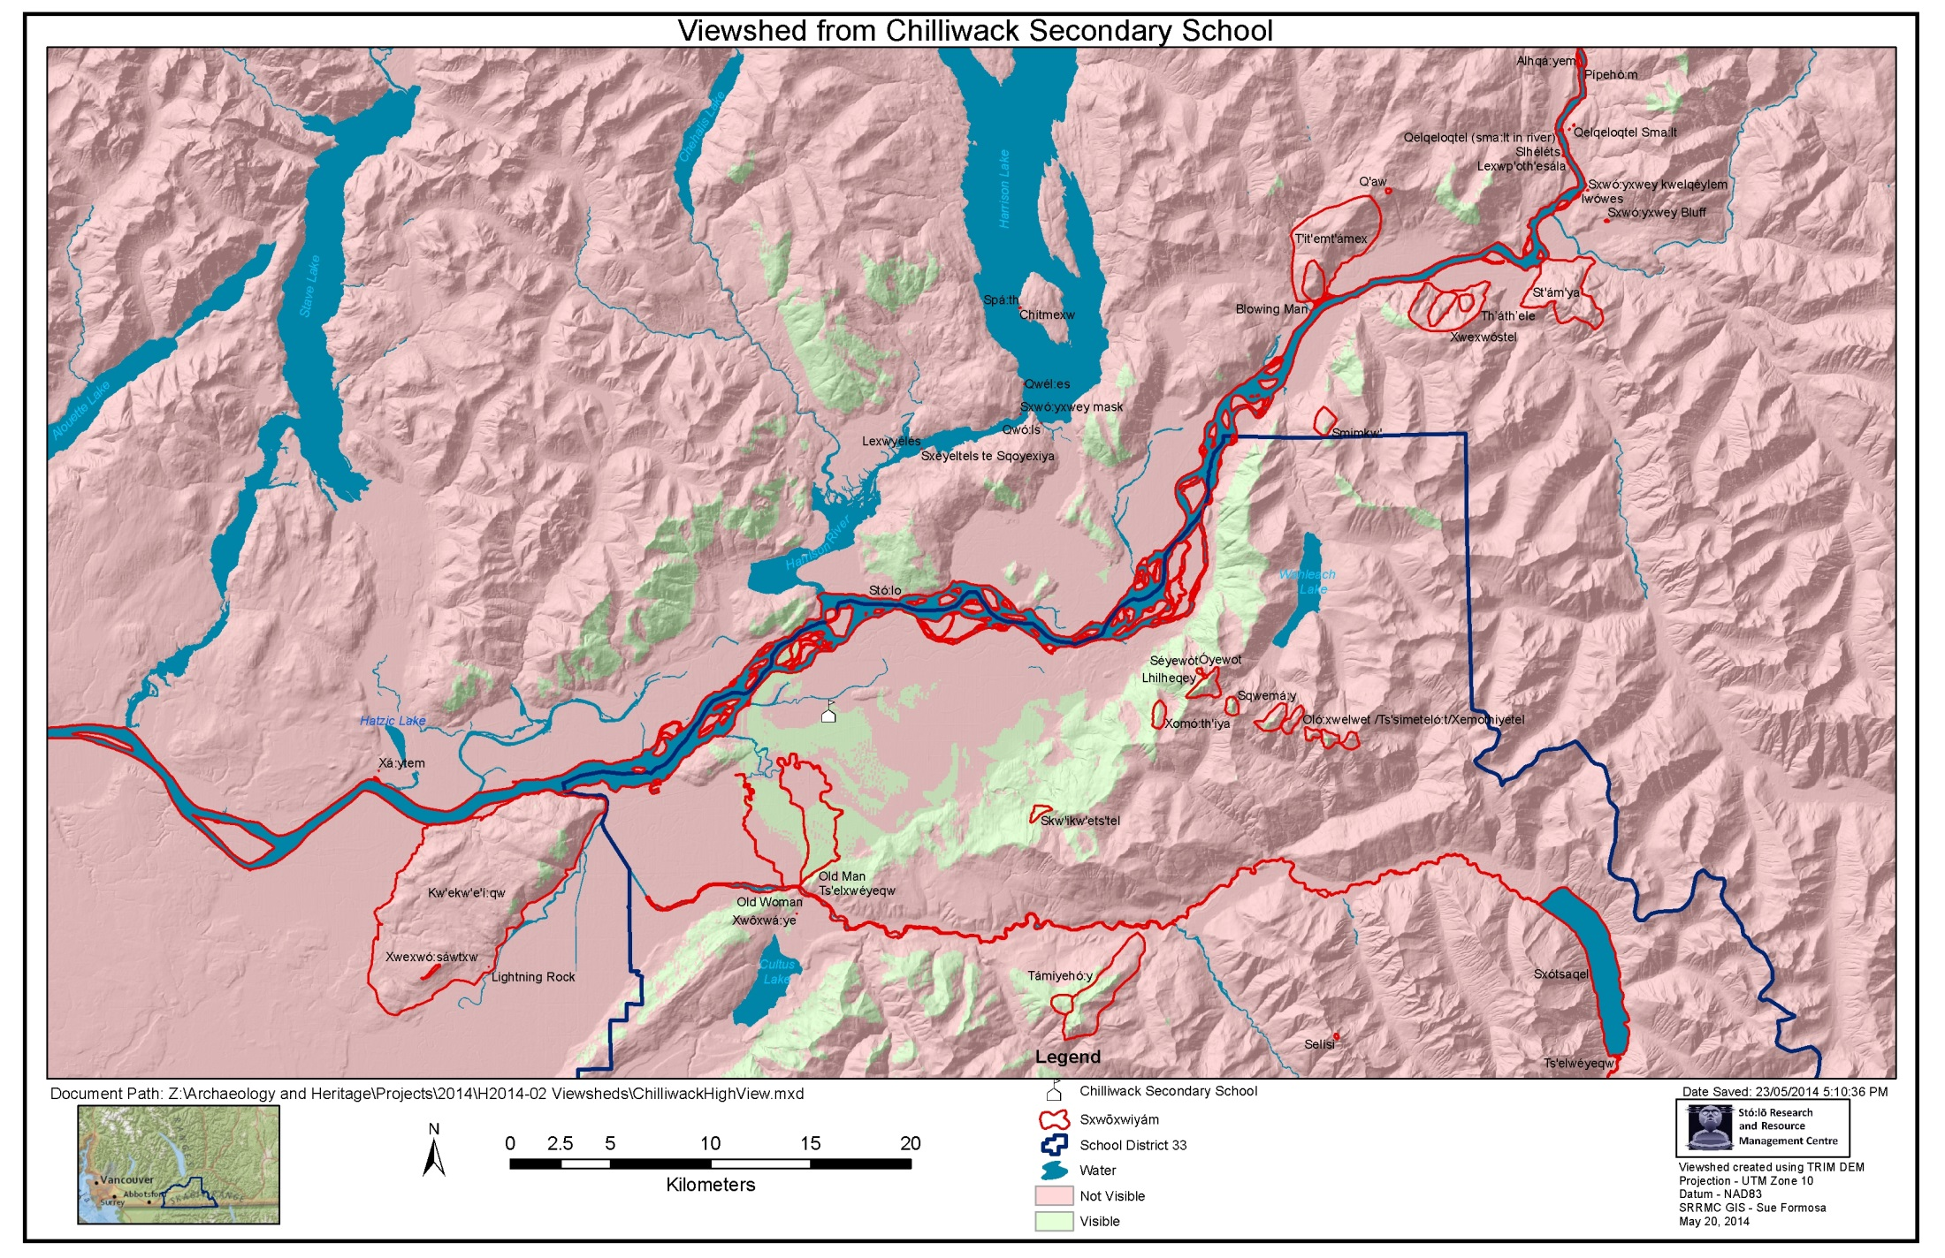

Slide 18
Halq'eméylem Place Names and Sxwōxwiyám
Features Visible from SD33 Schools
Sxwōxwiyám (spoken; possible film clips):
Lhílheqey
Kw’ekw’i:qw
T'amiyehó:y (Peak and Basin)
Coqualeetza
Seloysi
Kwi’kwets’el
Black Bear Story
Mt. Goat Story / Song

Slide 19
Watersheds
Connections / Stewardship
  Aquifer
  Drinking water
  Land Use and History

Slide 20
Indigenous Curriculum Resources & Sites of Learning
Map / List – hatchery & trails, ethnobotanical garden, Coqualeetza site, woodlot
Coqual. Trail
Hatchery & trail
Cheam wetlands/garden
Restoration area
Longhouse
A current project: Luckakuck Creek Riparian Restoration Project (Robby)

Slide 21
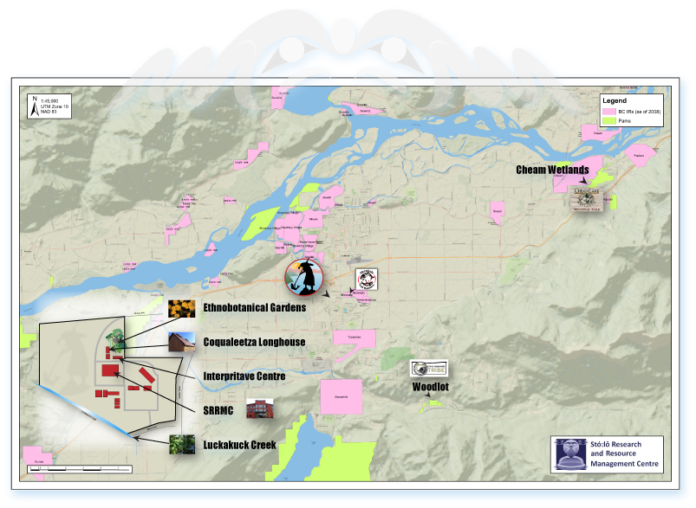
Indigenous Curriculum Resources &
Sites of Learning – Location Map

Slide 22
Acknowledgements
School District no. 33
Brenda Point, Principal, Chilliwack Aboriginal Education
Brad Driscoll and Participants in the Project
Sue Formosa, GIS mapping, SRRMC
Mike Pearson, Registered Biologist, Pearson Ecological
Robby Smoker-Peters, Research Assistant, SRRMC
Jared Deck, Stó:lō Shxwelí Language Program / SRRMC

Slide 23
Intellectual Property Rights and Terms of Use
  The information included in this presentation was developed for educational purposes, by the Stó:lō Nation. The intellectual property rights / copyright for some of the information contained with is held by the Stó:lō Nation or otherwise by the Stó:lō community, Stó:lō families or individuals. The authority to use this information is held by those owners. The sharing and use of this presentation and its content is exclusively for educational, non-commercial purposes. The information contained within is considered to be community verified as a factor of its use.

